Slide 1
Chapter 12:
Social Psychology
Notes:
Scales (Just world)
Locus of control

Slide 2
WHAT IS SOCIAL PSYCHOLOGY?
Social psychology deals with all kinds of interactions between people
Social psychologists believe that an individual’s thoughts, feelings, and behaviors are influenced by social situations.
Intrapersonal topics – emotions and attitudes, the self, and social cognition.
Interpersonal topics – helping behavior, aggression, prejudice and discrimination, attraction and close relationship, and group processes and intergroup relationships.
Notes:
spans a wide range of how we connect: from moments of confrontation to moments of working together and helping others.

Slide 3
SITUATIONAL & DISPOSITIONAL INFLUENCES ON BEHAVIOR
Situationism – the view that our behavior and actions are determined by our immediate environment and surroundings.
Dispositionism – the view that our behavior is determined by internal factors (attribute of a person such as personality traits and temperament).
Used by personality psychologists.
Modern social psychologists often consider both the situation and individual.
Notes:
Which one seems better?
Situationism Traditionally used by social psychologists.
Dispositionism is favored in US

Slide 4
FUNDAMENTAL ATTRIBUTION ERROR (1)
Fundamental attribution error – tendency to overemphasize internal factors as explanations/attributions for the behavior of other people and underestimate the power of the situation.
People tend to fail to recognize when a person’s behavior is due to situational variables.

Slide 5
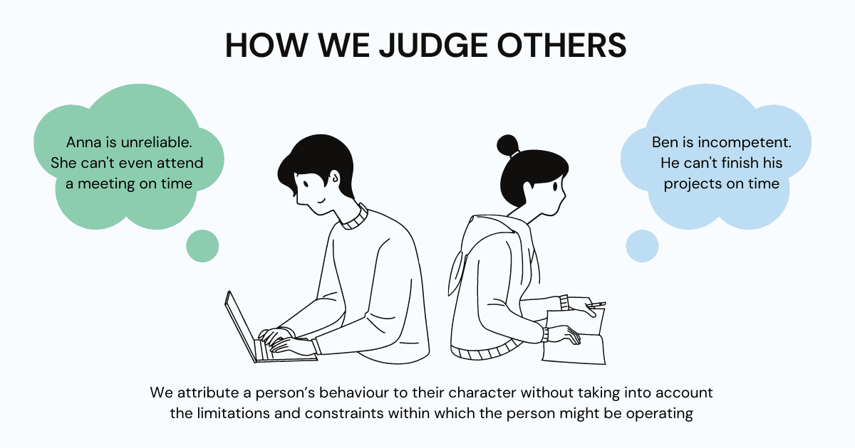

Slide 6
FUNDAMENTAL ATTRIBUTION ERROR (2)
Quizmaster Study:
Participants were randomly assigned to play the role of either the questioner or participant.
Questioners developed difficult questions to which they knew the answers.
Participants answered questions correctly 4/10 times.
Participants tended to disregard the influence of the situation and wrongly concluded that a questioner’s knowledge was greater than their own.

Slide 7
IS THE FUNDAMENTAL ATTRIBUTION ERROR A UNIVERSAL PHENOMENON?
Individualist vs. Collectivist cultures?
Are Individualist cultures more prone to the fundamental attribution error?
Notes:
Research suggests that people from an individualistic culture have the greatest tendency to commit the fundamental attribution error.
People from collectivistic cultures, such as some Asian cultures, are more likely to emphasize relationships with others than to focus primarily on the individual.
Suggests that Focusing on others provides a broader perspective including both situation and cultural influences.

Slide 8
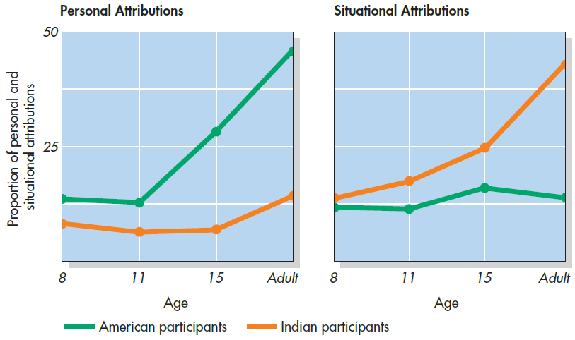
Fundamental Attribution Error: A Western Bias?
Notes:
Figure 4.6 Fundamental Attribution Error: A Western Bias? American and Asian Indian participants of varying ages described the causes of negative actions they had observed. Among young children, there were no cultural differences. With increasing age, however, Americans made more personal attributions and Indian participants made more situational attributions. Explanations for positive behaviors followed a similar pattern. This finding suggests that the fundamental error is a Western phenomenon. Based on Miller (1984).

Slide 9
ACTOR-OBSERVER BIAS
Actor-observer bias – phenomenon of explaining other people’s behaviors are due to internal factors and our own behaviors are due to situational forces.
We often make the fundamental attribution error because we do not have enough information to make a situational explanation about the person’s behavior.
However, when we explain our own behaviors, we have more information available and are more likely to make situational explanations.

Slide 10
SELF-SERVING BIAS (1)
Self-serving bias – tendency of an individual to take credit by making dispositional or internal attributions for positive outcomes but situational or external attributions for negative outcomes.
Protects self-esteem - allows people to feel good about their accomplishments.
Attribution – a belief about the cause of a result.

Slide 11
SELF-SERVING BIAS (2)
Three dimensions of attribution:
Locus of control – internal vs external.
Stability –extent to which the circumstances are changeable.
Controllability – extent to which the circumstances can be controlled.
  When our team wins we make attributions such as it’s talented (internal), works hard (stable), and uses effective strategies (controllable).
  When our team loses we might say the other team has more experienced players (external), the other team played at home (unstable), and the weather affected our teams performance (uncontrollable).

Slide 12
JUST WORLD HYPOTHESIS
A consequence of the tendency to provide dispositional explanations for behavior is victim blame.
Just-world hypothesis – belief that people get the outcomes they deserve.
Based on the belief that the world is a fair place and therefore good people experience positive outcomes, and bad people experience negative outcomes.
Allows people to feel that the world is predictable and we have some control over life outcomes.
People who hold just-world beliefs tend to blame the people in poverty for their circumstances, ignoring situational and cultural causes of poverty.

Slide 13
AGGRESSION
Aggression – seeking to cause harm or pain to another person.
Hostile aggression – motivated by feelings of anger with intent to cause pain.
Instrumental aggression – motivated by achieving a goal and does not necessarily involve intent to cause pain.
Frustration Aggression Theory:
When humans are prevented from achieving an important goal, they become frustrated and aggressive.

Slide 14
EVOLUTIONARY THEORY OF AGGRESSION
Evolutionary theory - aggression serves an evolutionary function.
Men are more likely to show aggression - likely serves to display dominance over other males.
  To protect a mate.
  To perpetuate the male’s genes.
Human males and nonhuman male primates endeavor to gain and display dominance over other males, as demonstrated in the behavior of these monkeys.

Slide 15
THE BYSTANDER EFFECT
Kitty Genovese (1964)
Attacked and killed with a knife outside her apartment building.
Residents in the apartment building heard her scream for help numerous times but did nothing.
Latane & Darley
Bystander Effect – phenomenon in which a witness/bystander does not volunteer to help a victim or person in distress.
Based on the social situation, not personality variables.
Diffusion of responsibility – tendency for no one in a group to help because the responsibility to help is spread throughout the group.

Slide 16
PROSOCIAL BEHAVIOR AND ALTRUISM
Prosocial behavior – voluntary behavior with the intent to help other people.
Altruism – people’s desire to help others even if the costs outweigh the benefits of helping.
The events of 9/11 unleashed an enormous show of altruism and heroism on the parts of first responders and many ordinary people.
Does true altruism exist? Can we engage in a behavior for non-selfish means?
Notes:
Theories on the Motivation to Help
Empathy:
Empathy is the capacity to understand another person’s perspective, to feel what he/she feels.
Emphatic people make emotional connections with others and feel compelled to help.
Altruism is a form of selfless helping (not motivated by benefits).
Feeling good after helping is a consequence, not a cause.
Helping is self-serving because our egos are involved, and we receive benefits.

Slide 17
FORMING RELATIONSHIPS
What influences who we become friends with and form romantic relationships with?
Proximity – the people with whom you have the most contact.
Similarity – people who are similar to us in background, attitudes, and lifestyle.
Important components of relationships:
Reciprocity – the give and take in relationships. We contribute to relationships, but expect to receive benefits in return.
Self-disclosure – the sharing of personal information.
  Leads to more intimate connections.

Slide 18
How Couples Tend to Meet: Past and Present
Notes:
Figure 9.3 How Couples Tend to Meet: Past and Present
Source: Rosenfeld et al., 2019.

Slide 19
SELF-PRESENTATION
THE SELF
SOCIAL ROLES
SOCIAL NORMS
SCRIPTS

Slide 20

Sense of Self
ABCs of the self:
  Affect (emotion)
  Behavior
  Cognition
Product of consciousness, but heavily influenced by social factors

Slide 21
The Self-Concept
Self-concept
  The sum total of an individual’s beliefs about his or her own personal attributes.
  Includes roles, social connections, beliefs/values, etc.
  Everything that makes up one’s identity!
Self-schema
  A belief people hold about themselves that guides the processing of self-relevant information.
  Can have multiple! (example: Identifying w/ 2 cultures)

Slide 22
Self-awareness
Theory of mind: Understanding that one’s own thoughts and feelings are separate from others
General understanding that you are a unique individual

Slide 23
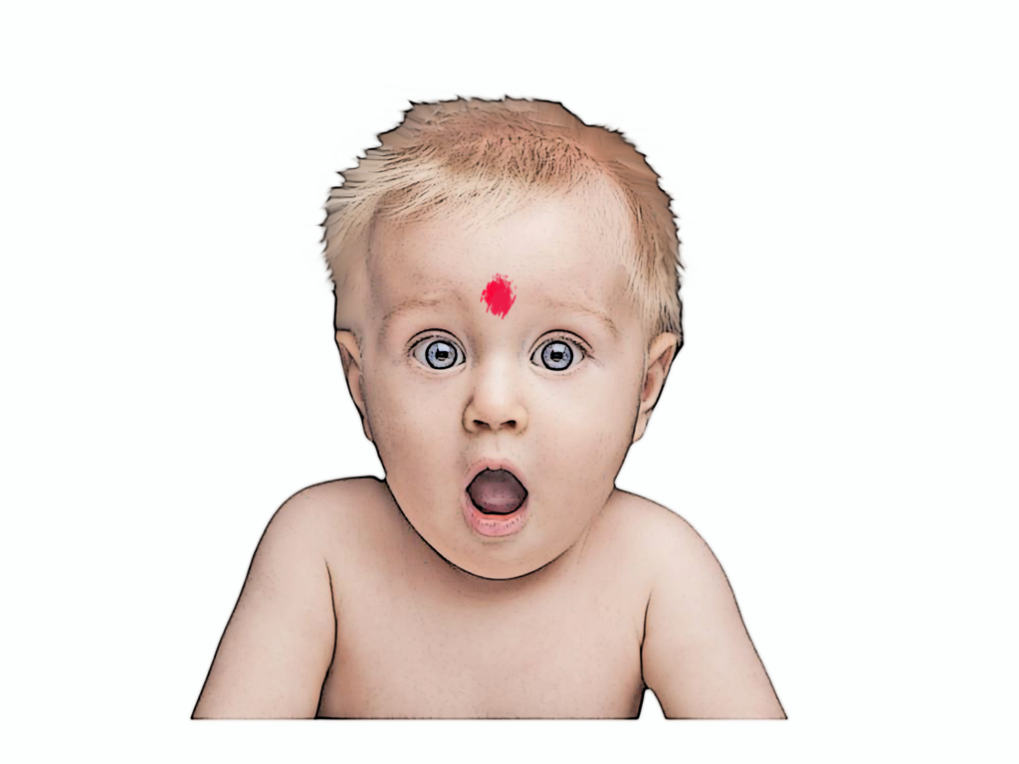
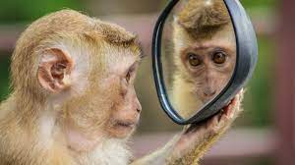
Assessing Self-Awareness in Animals
Do individuals recognize themselves?
  Mirror test used with babies and animals
A mark is placed on the baby/animal’s face
  Attempts to touch or the remove the mark are taken as signs that they recognize themselves in the mirror

Slide 24
When does self-awareness begin?
Humans: 1 year-olds sometimes notice the mark in the mirror; all humans easily pass test by the age of 3
Animals: Only great apes (chimpanzees, gorillas, orangutans) seemed capable of self-recognition.
Seems “the-self” is mostly (but not entirely!) a human concept?

Slide 25
Learning About One’s Self
Introspection: Achieving insight into their own beliefs, attitudes, emotions, desires, personalities, and motivations?
  “Inward thinking”
  Problems?
  Most people overestimate the positives when
  self-assessing.

Slide 26
Influences of Other People
We often describe ourselves by comparing ourselves to others.
  Social comparison theory (Festinger)
When people are uncertain of their abilities or opinions, they evaluate themselves by comparison to similar others.
We learn by modeling! (By nature, we’re social creatures!)

Slide 27
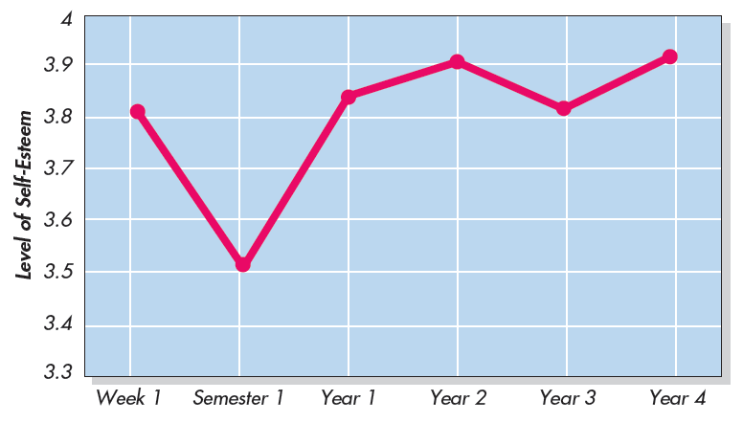
Self-Esteem Over the Course of a College Career
Notes:
Figure 3.8 Self-Esteem Over the Course of a College Career In this longitudinal study of college students who were repeatedly tested, self-esteem
An evaluative component of the self.
Made up of many self-schemas.
Some parts they judge more favorably or see more clearly or as more important than other parts.
Self-esteem is multi-faceted: High self-esteem for one aspect, but low for another
dropped sharply during their first semester but then recovered and increased into their senior year. Chung et al., 2014.

Slide 28
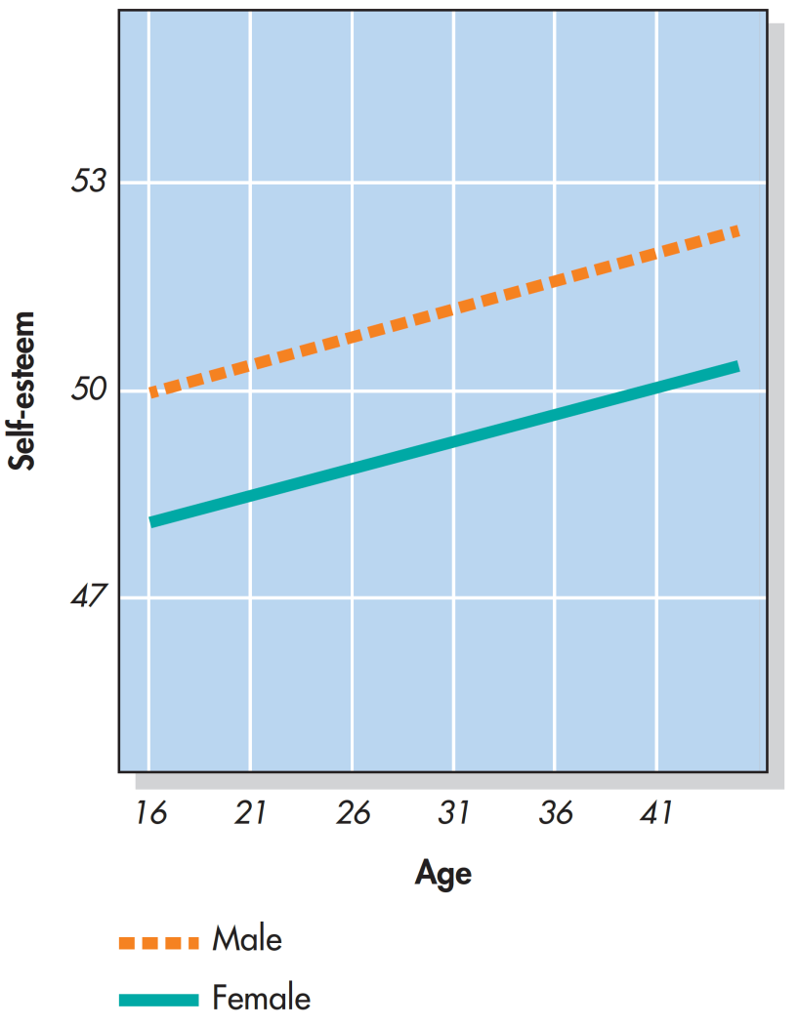
Gender Differences in Self-Esteem
Notes:
Figure 3.9 In an online study, nearly 1 million people rated their own self-esteem. In a pattern that was more pronounced in some countries than
others, these self-ratings were on average higher among men than women. You can also see that these ratings increased with age from adolescence to adulthood. Bleidorn et al., 2016, p. 402.

Slide 29
SOCIAL ROLES
Social role – a pattern of behavior that is expected of a person in a given setting or group.
We each have several social roles.
Defined by culturally shared knowledge.
Behavior related to social roles varies across situations.
Notes:
What roles do you have?

Slide 30
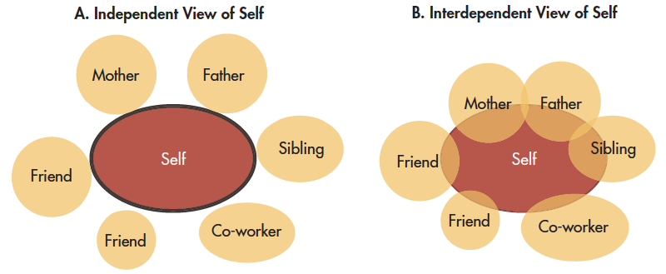
Cultural Conceptions of Self
Individualism
Collectivism
Notes:
Figure 3.5 Cultural Conceptions of Self As depicted here, different cultures foster different conceptions of the self. Many Westerners have an independent view of the self as an entity that is distinct, autonomous, and self-contained. Yet many Asians, Africans, and Latin Americans hold an interdependent view of the self that encompasses others in a larger social network.
Based on Marcus, and Kitayama, 1991

Slide 31
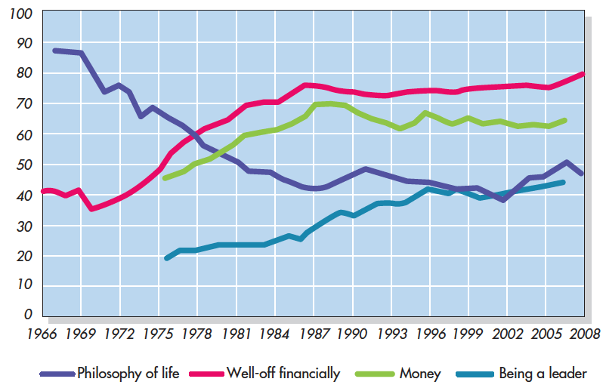
Generational Differences in American Cultural Orientation
Notes:
Figure 3.7 Generational Differences in American Cultural Orientation Over the years, surveys have been administered to millions of Americans who grew up in the 1940s–1950s (“baby boomers”), 1960s–1970s (“GenX’ers”), and 1980s–1990s (“Millennials”). From the responses of high school and college students from 1966 to 2009, it seems that compared to boomers, later generations were more focused on money, fame, and self-image, and less concerned with affiliation, community, and civic engagement. These changes suggest that American culture is more individualistic today than it was a half century ago.
Based on Twenge et a., 2012.

Slide 32
SOCIAL NORMS & SCRIPTS
Social norm – a group’s expectation of what is appropriate and acceptable behavior for its members.
How are we supposed to behave and think?
What are we expected to talk about?
What are we expected to wear?
Script – a person’s knowledge about the sequence of events expected in a specific setting.
How do you act when you walk into an elevator, on the first day of school, in a restaurant?
Scripts vary between cultures.
Important sources of information to guide behavior in situations.

Slide 33

The Stanford Prison Experiment (1971)
Simulated a prison environment
  Individuals randomly selected to be “guards” or “prisoners”
  Given uniforms, fully thrown into roles
  “Guards” engaged in all sorts of psychological abuse towards “prisoners”
Notes:
Headed by Phillip Zimbardo

Slide 34
The Stanford Prison Experiment
Demonstrated the power of social roles, social norms, and scripts.
A mock prison was constructed and participants (male college students), were randomly assigned to play the role of prisoners or guards.
In a very short amount of time, the guards started to harass the prisoner in an increasingly sadistic manner.
Prisoners began to show signs of severe anxiety and hopelessness.
The two week study had to be ended after six days.
Social norms required guards to be authoritarian and prisoners to be submissive.
Scripts influenced the way guards degraded the prisoners by making them do push-ups and removing privacy.

Slide 35
ATTITUDES AND PERSUASION
COGNITIVE DISSONANCE
PERSUASION

Slide 36
ATTITUDE
Attitude – our evaluation of a person, an idea, or an object.
Can be positive or negative.
Influenced by external forces and internal factors that we control
3 components:
Affective component – feelings.
Behavioral component – the effect of the attitude on behavior.
Cognitive component – belief and knowledge.
Notes:
Just like the self!

Slide 37
Cognitive Dissonance Theory: The Classic Version
Theory holding that inconsistent cognitions arouses psychological tension
  People are then motivated to reduce this tension!
Conditions for cognitive dissonance:
  An attitude-discrepant behavior was chosen freely and with some knowledge of the consequences
  “Acting out of character”

Slide 38
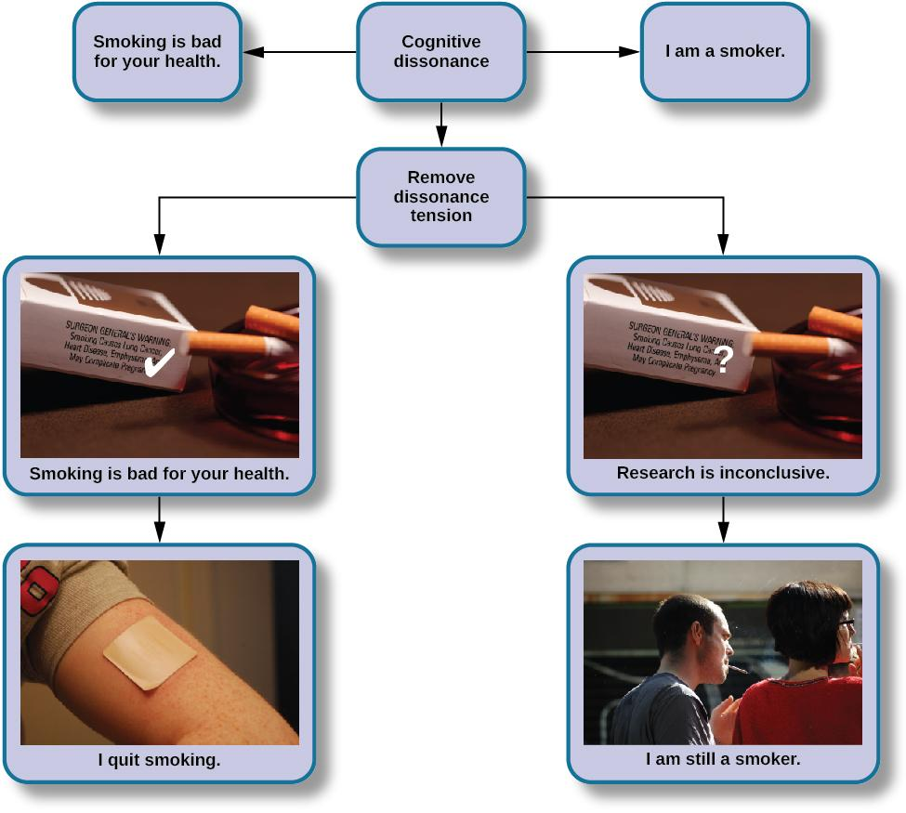
COGNITIVE DISSONANCE

Slide 39
Ways to Reduce Dissonance
Techniques | Examples
Change your attitude. | “I don’t really need to be on a diet.”
Change your perception of the behavior. | “I hardly ate any ice cream.”
Add consonant cognitions. | “Chocolate ice cream is very nutritious.”
Minimize the importance of the conflict. | “I don’t care if I’m overweight---life is short!”
Reduce perceived choice. | “I had no choice; the ice cream was served for this special occasion.”
Notes:
Table 6.4 Ways to Reduce Dissonance “I need to be on a diet, yet I just dove head first into a tub of chocolate fudge brownie ice cream.” If this were you, how would you reduce dissonance aroused by the discrepancy between your attitude and your behavior?

Slide 40
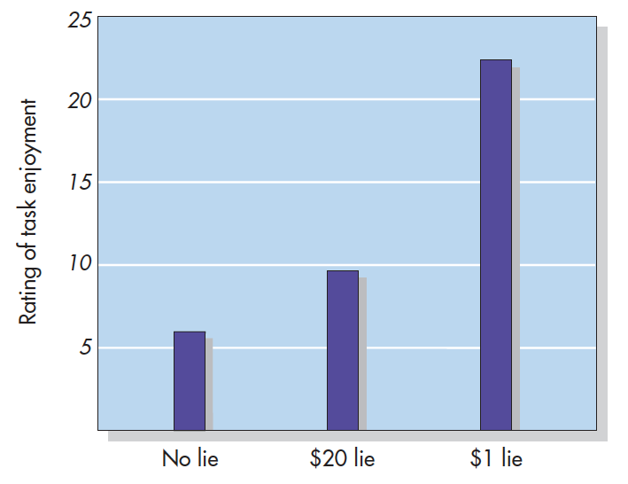
Festinger & Carlsmith (1959)
Notes:
Figure 6.12 The Dissonance Classic Participants in a boring experiment (attitude) were asked to say that it was enjoyable (behavior) to a fellow student. Those in one group were paid $1 to lie; those in a second group were offered $20. Members of a third group, who did not have to lie, admitted that the task was boring. So did the participants paid $20, which was ample justification for telling a lie. Participants paid only $1, however, rated the task as more enjoyable. Behaving in an attitude-discrepant manner without justification, these latter participants reduced dissonance by changing their attitude. Based on Festinger, L. and Carlsmith, J. M., “Cognitive Consequences and Forced Compliance,” Journal of Abnormal and Social Psychology vol. 58 (pp. 203–210). Copyright © 1959 by the American Psychological Association. Reprinted by permission.

Slide 41
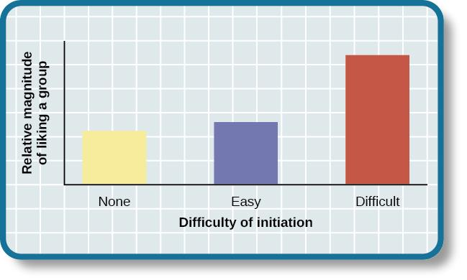
THE EFFECT OF INITIATION
Justification of effort also has a distinct effect on a person liking a group.
A difficult initiation into a group influences us to like the group more.
Aronson and Mills Experiment (1959):
College students volunteered to join a group that would regularly to discuss the psychology of sex.
3 conditions – no initiation, easy initiation, difficult initiation.
Students in the difficult initiation condition liked the group more than students in other conditions due to the justification of effort.

Slide 42
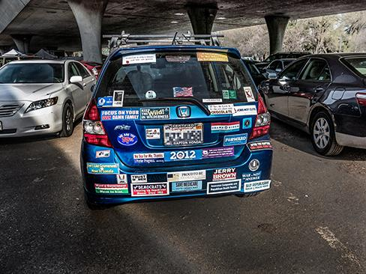
PERSUASION
Persuasion – process of changing our attitudes toward something based on some kind of communication.
How do people convince others to change their attitudes, beliefs, and behaviors?
We encounter attempts at persuasion attempts everywhere. Persuasion is not limited to formal advertising; we are confronted with it throughout our everyday world.

Slide 43
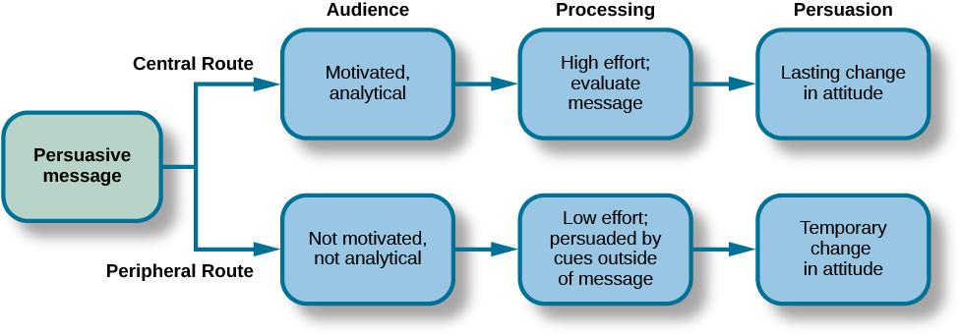
ELABORATION LIKELIHOOD MODEL (PETTY & CACIOPPO,1986)
Notes:
Persuasion can take one of two paths, and the durability of the end result depends on the path.
Central Route
Logic driven.
Uses data and facts.
Direct route to persuasion focusing on the quality of information.
Works best when audience is analytical and willing to engage in processing of the information.
Peripheral Route
Indirect route.
Uses peripheral cues to associate positivity with the message.
Uses characteristics such as positive emotion or celebrity endorsement.
Results in less permanent attitude change.

Slide 44

Route Selection
Source—who is presenting the message
Message—says what and in what context
Audience—to whom the message is directed

Slide 45
Who Do You Trust?
Occupation | % Very high/High
Nurses
Medical doctors
Pharmacists
High school teachers
Police officers
Real estate agents
Lawyers
Business executives
Telemarketers
Car salespeople
Members of Congress
Notes:
Table 6.1 Who Do You Trust? Please tell me how you would rate the honesty and ethical standards of people in these different fields—very high, high, average, low, or very low?
In December 2018, a Gallup poll was conducted to determine the level of honesty attributed to people from various occupational groups. Indicated alongside are the percentages of respondents who rated each group as “high” or “very high” in honesty.

Slide 46
Who Do You Trust?
Occupation | % Very high/High
Nurses | 84
Medical doctors | 67
Pharmacists | 66
High school teachers | 60
Police officers | 54
Real estate agents | 25
Lawyers | 19
Business executives | 17
Telemarketers | 9
Car salespeople | 8
Members of Congress | 8
Notes:
Table 6.1 Who Do You Trust? Please tell me how you would rate the honesty and ethical standards of people in these different fields—very high, high, average, low, or very low?
In December 2018, a Gallup poll was conducted to determine the level of honesty attributed to people from various occupational groups. Indicated alongside are the percentages of respondents who rated each group as “high” or “very high” in honesty.

Slide 47
CONFORMITY, COMPLIANCE & OBEDIENCE
SOLOMON ASCH
STANLEY MILGRAM
GROUPTHINK
GROUP POLARIZATION

Slide 48
Conformity
Tendency of people to change their perceptions, opinions, or behavior in ways that are consistent with social or group norms.
Would you call yourself a conformist or a nonconformist?
  When did you last breach social norms?
Researchers have found that people in North America often identify themselves as nonconformists.

Slide 49
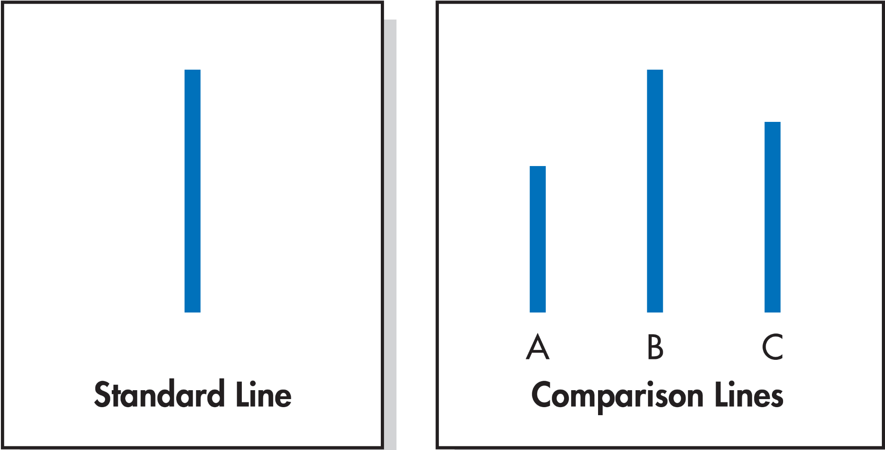
Line Judgment Task Used in Asch’s Conformity Studies
Notes:
Figure 7.4 Line Judgment Task Used in Asch’s Conformity Studies Which comparison line—A, B, or C—is the same in length as the standard line? What would you say if you found yourself in the presence of a unanimous majority that answered A or C? The participants in Asch’s experiments conformed to the majority about a third of the time. (Asch, 1955)

Slide 50
The Early Classics (1)
Asch’s study results
  Confederates stated incorrect judgments for 12 of the 18 presentations (67%!)
Subjects conformed to the incorrect majority 37% of the time
  50% went along at least half of the critical presentations.
  25% refused to agree on any incorrect group judgments.
  Remaining participants conformed on an occasional basis.
Notes:
Asch effect – the influence of the group majority on an individual’s judgement.
In Asch’s study there was one naive subject, the rest were confederates who purposely gave the wrong answer. 76% of participants conformed to group pressure at least once by also indicating the incorrect line.
What factors make a person more likely conform?
The size of the majority – the greater the majority, the more likely an individual will conform.
The presence of another dissenter – causes conformity rates to drop to near zero.
The public or private nature of the responses – public responses cause more conformity than private.

Slide 51
The Early Classics (2)
Asch’s study – Why did people conform?
  Participants felt they were in an awkward position.
  People will sometimes conform, even when they are not convinced the group is right, to avoid feeling “conspicuous” and “crazy,” or like a “misfit.”

Slide 52
Why Do People Conform?
A desire to be right (informational influence)
  Want to make good and accurate judgments of reality and assume that when others agree on something, they must be right
Fear of ostracism (normative influence)
  Fear the consequence of rejection that follows deviance

Slide 53
MOTIVATION TO CONFORM
Normative social influence – people conform to the group norm to fit in, to feel good, and to be accepted by the group.
Informational social influence – people conform because they believe the group is competent and has the correct information, particularly when the task or situation is ambiguous.
Notes:
People in crowds tend to take cues from others and act accordingly.

Slide 54
Compliance
The norm of reciprocity dictates that we treat others as they have treated us.
  Leads us to feel obligated to repay others for acts of kindness
  Can also be used to sanction retaliation against those who cause us harm
People may feel compelled to reciprocate, but that feeling—at least for small acts of kindness—is relatively short-lived.

Slide 55
Sequential Request Strategies
Request Shifts | Technique | Description
From small to large | Foot-in-the-door | Begin with a very small request, secure agreement, then make a separate, larger request.
 | Lowballing | Secure agreement with a request and then increase the size of that request by revealing hidden costs.
From large to small | Door-in-the-face | Begin with a very large request that will be rejected, then follow that up with a more modest request.
 | That’s-not-all | Begin with a somewhat inflated request, then immediately decrease the apparent size of that request by offering a discount or bonus.
Notes:
Table 7.3 Sequential Request Strategies Various compliance techniques are based on a sequence of two related requests. Click! The first request sets the trap. Snap! The second captures the prey. Research has shown that the four sequential request strategies summarized in this table are all effective.
credit TK

Slide 56
Obedience
Change in behavior as a result of a direct command from an authoritative figure.
May also be obtained by the symbols of authority, even without the necessary credentials
  Titles, uniforms, badges, or the trappings of success

Slide 57
Milgram’s Research: Forces of Destructive Obedience
Subject of much ethical debate
  Potential psychological harm to participants
  Profound contribution has made to our understanding of human nature and an important social problem
Experiment was presented to participants as a study on the effects of punishment on learning
  Participants exhibited an alarming degree of obedience, administering an average of 27 out of 30 possible shocks.
Notes:
https://www.youtube.com/watch?v=Kzd6Ew3TraA

Slide 58
The Learner’s Protests in the Milgram Experiment (1 of 3)
  75 volts Ugh!
  90 volts Ugh!
  105 volts Ugh! (louder)
  120 volts Ugh! Hey, this really hurts!
  135 volts Ugh!!
  150 volts Ugh!!! Experimenter! That’s all. Get me out of here. I told you I had heart trouble. My heart’s starting to bother me now. Get me out of here, please. My heart’s starting to bother me. I refuse to go on. Let me out.
  165 volts Ugh! Let me out! (shouting)
  180 volts Ugh! I can’t stand the pain. Let me out of here! (shouting)
  195 volts Ugh! Let me out of here. Let me out of here. My heart’s bothering me. Let me out of here! You have no right to keep me here! Let me out! Let me out of here! Let me out! Let me out of here! My heart’s bothering me. Let me out! Let me out!
Notes:
Table 7.4 The Learner’s Protests in the Milgram Experiment As participants administered progressively more intense shocks, they heard the learner moan, groan, protest, and complain. All participants heard the same programmed set of responses. Eventually, the learner fell silent and ceased to respond. From Milgram, S., Obedience to authority: An experimental view (pp. 56–57). Copyright © 1974 by Stanley Milgram.

Slide 59
The Learner’s Protests in the Milgram Experiment (2 of 3)
  210 volts Ugh!! Experimenter! Get me out of here. I’ve had enough. I won’t be in the experiment any more.
  225 volts Ugh!
  240 volts Ugh!
  255 volts Ugh! Get me out of here.
  270 volts (Agonized scream) Let me out of here. Let me out of here. Let me out of here. Let me out. Do you hear? Let me out of here.
  285 volts (Agonized scream)
  300 volts (Agonized scream) I absolutely refuse to answer any more. Get me out of here. You can’t hold me here. Get me out. Get me out of here.
  315 volts (Intensely agonized scream) I told you I refuse to answer. I’m no longer part of this experiment.
  330 volts (Intense and prolonged agonized scream) Let me out of here. Let me out of here. My heart’s bothering me. Let me out, I tell you. (Hysterically) Let me out of here. You have no right to hold me here. Let me out! Let me out! Let me out! Let me out of here! Let me out! Let me out!
Notes:
Table 7.4 The Learner’s Protests in the Milgram Experiment (cont'd.) As participants administered progressively more intense shocks, they heard the learner moan, groan, protest, and complain. All participants heard the same programmed set of responses. Eventually, the learner fell silent and ceased to respond. From Milgram, S., Obedience to authority: An experimental view (pp. 56–57). Copyright © 1974 by Stanley Milgram.

Slide 60
The Learner’s Protests in the Milgram Experiment (3 of 3)
Experimenter’s responses to participants’ expressions of concern or reluctance to continue
  Please continue (or please go on).
  The experiment requires that you continue.
  It is absolutely essential that you continue.
  You have no other choice; you must go on.

Slide 61
UNDERSTANDING PREJUDICE &
DISCRIMINATION
Prejudice – a negative attitude and feeling toward an individual based solely on one’s membership in a particular social group.
“I hate Yankees fans; they make me angry.”
Stereotype – a specific belief or assumption about individuals based solely on their membership in a group.
“Yankees fans are arrogant and obnoxious”.
Discrimination – a negative action toward an individual as a result of one’s membership in a particular group.
“I would never hire nor become friends with a person if I knew he or she were a Yankees fan.”
Why do prejudice and discrimination exist?
Social learning.
Conformity to social norms.

Slide 62
TYPES OF PREJUDICE & DISCRIMINATION
Racism
Prejudice and discrimination against an individual based on race.
Dual Attitudes Model:
Explicit – conscious and controllable.
Implicit – Unconscious and uncontrollable.
Most people no longer show extreme racial bias on measures of explicit attitudes but measures of implicit attitudes often provide evidence of mild to strong racial bias/prejudice. This can explain why modern forms of racism are hard to detect.
Sexism
Prejudice and discrimination toward individuals based on their sex.
Common examples include gender role expectations and expectations for how a gender group should behave.
Can exist on a societal level – employment and education opportunities.
Women now have many jobs previously closed to them, though they still face challenges in male-dominated occupations.

Slide 63
IN-GROUPS & OUT-GROUPS
In-groups – a group that we identify with or see ourselves as belonging to.
Out-groups – a group that we view as fundamentally different from us.
In-group bias – prejudice and discrimination because the out-group is perceived as different and is less preferred than our in-group.
We want to feel good and protect our in-groups.
Forces that promote reconciliation between groups:
The expression of empathy.
Acknowledgement of past suffering on both sides.
The halt of destructive behaviors.
Scapegoating – the act of blaming an out-group when the in-group experiences frustration or is blocked from obtaining a goal.

